Slide 1
ROPEWAYS IN NORTH AMERICA
IMPACTS, BENEFITS AND OUTLOOK
Jim Fletcher, P.E.
Engineering Specialties Group

Slide 2
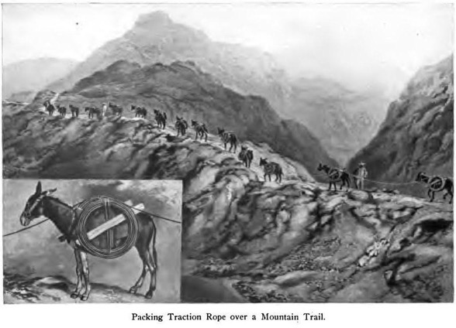
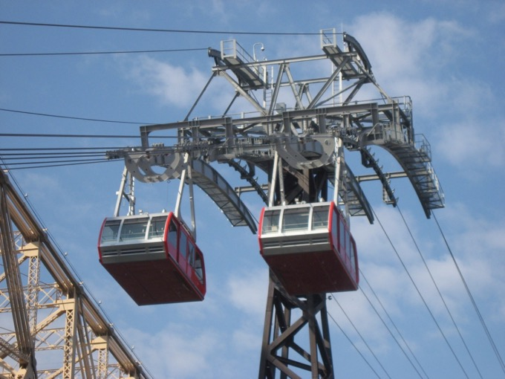

PURPOSE
HISTORICAL IMPACTS AND BENEFITS OF ROPEWAYS
OUTLOOKS FOR ROPE TRASNPORTATION-NEXT 25 YEARS
Notes:
The purpose of the analysis and discussion that follows is to provide the historical Impacts and Benefits and to provide Outlooks for rope transportation in North America for the next 25 years.

Slide 3
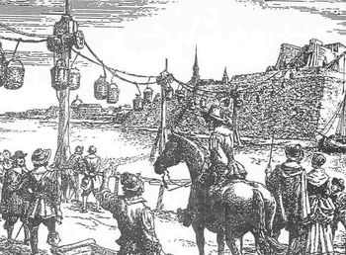
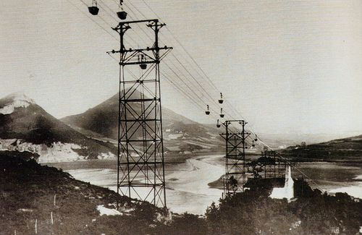
HISTORICAL IMPACTS
First Used in Asiatic Countries in the 1400’s.
Used by the Spanish Conquistadors in the Gold Mines of Columbia in South America circa 1530s.
Significant use in North America in the late 1800’s for Gold and Silver
4000 Material Ropeways Built in North America since 1860
Notes:
Rope was first reported in use for aerial transport of personnel and goods in the rugged Asiatic countries of India, China and Japan in the 1400s. Early ropeway development moved, we believe, from the Asiatic countries to Europe in the 1400s. It is reported that the Spanish Conquistadors used ropeway technology in the gold mines of Columbia in South America circa 1530s.
The late 1800s saw the increasing use of the ropeway for moving materials especially precious metal ores in the mountain regions of North America. This was made possible by the development of wire rope technology in the mid 1800s. It is estimated that 4000 material ropeways have been built in North America since 1860.

Slide 4
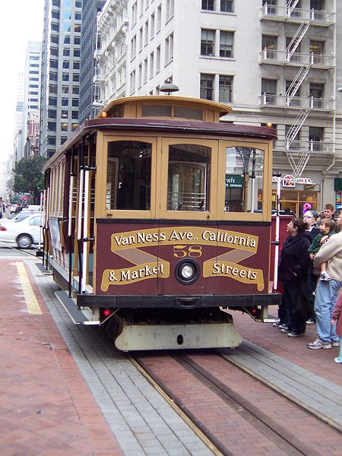
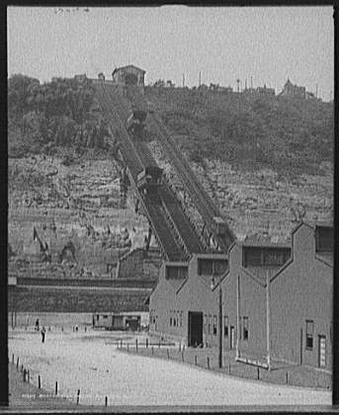
HISTORICAL IMPACTS
PASSENGER TRANSPORT – FUNICULARS
SAN FRANCISCO CABLE CARE – 1870s
LOS ANGLES ECHO MOUNTAIN – 1890s
LOS ANGLES MT. WASHINGTON – 1900s
CHATTANOGGA LOOKOUT MTN – 1895
PITTSBURGH DUQUESNE - 1877
PITTSBURGH MONONGAHELIA - 1870
Notes:
The ropeway as a passenger transport device in an urban setting had an early experience in San Francisco in the 1870’s with the introduction of the cable car. Other cites in the United States and Canada started to utilize funicular railways at various locations in the early 1900’s.
The Duquesne Incline in Pittsburgh, Pennsylvania built in 1877 allowed residents to be transported to the top of Mount Washington and is operational today.

Slide 5
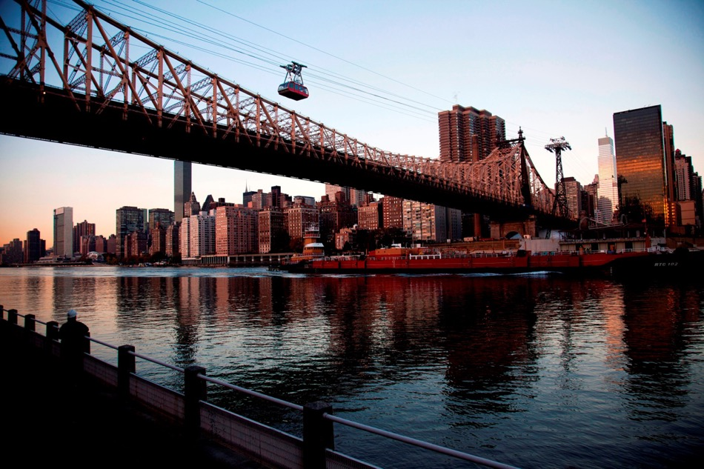
HISTORICAL IMPACTS
PASSENGER TRANSPORT – URBAN
ROOSEVELT ISLAND TRAM NEW YORK
Notes:
The one urban-transport aerial ropeway system in North America, recently modernized in 2010, is the Roosevelt Island Tramway which was started in 1976 to provide passenger transport from the Roosevelt Island residential community to mid town Manhattan traversing the East River.

Slide 6
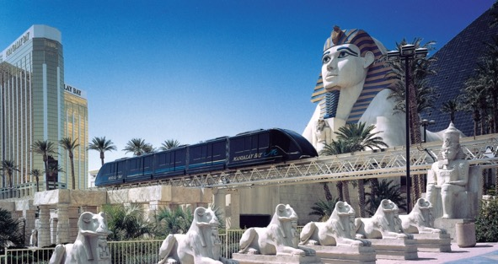
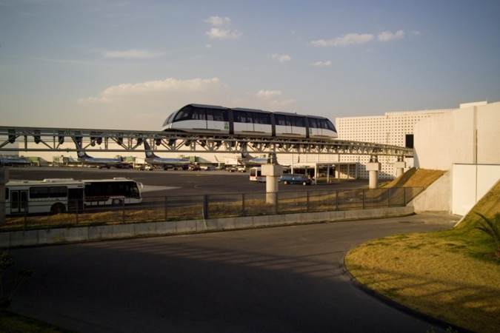
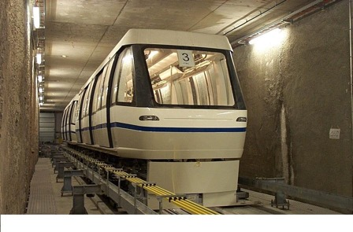
HISTORICAL IMPACTS
PASSENGER TRANSPORT – AUTOMATED PEOPLE MOVERS
CIRCUS CIRCUS SHUTTLE LAS VEGAS – 1981
MUD ISLAND MONORAIL MEMPHIS, TN – 1982
CINCINNATI AIRPORT - 1994
Mandalay Bay
Mexico City Airport
Zurich Airport
Notes:
In the late1960’s the automated people mover (APM) was conceived and implemented in North America. The rope propelled systems have played a role in this development of APMs. In May of 1981, the VSL Metro Shuttle began carrying passengers at the Circus-Circus Hotel in Las Vegas. In 1982 the Mud Island Monorail, the first automated suspended shuttle, began operation in Memphis, Tennessee.
In 1994 the first airport rope propelled, air supported, APM was delivered at the Cincinnati Airport.

Slide 7
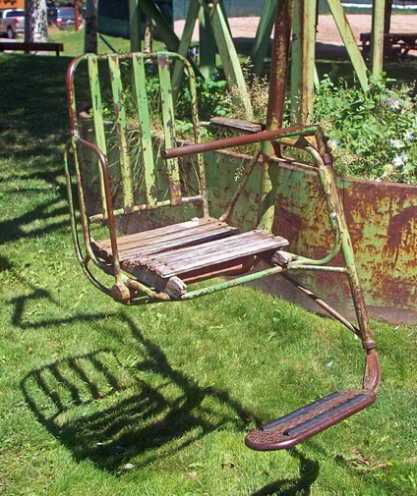
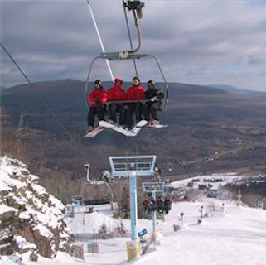
HISTORICAL IMPACTS
PASSENGER TRANSPORT – SKI RESORT ROPEWAYS
FIRST CHAIRLIFT SUN VALLEY IDAHO - 1937
FIRST DOUBLE CHAIRLIFT BERTHOUD PASS - 1946
1300 AERIAL SYSTEMS 1960 TO 1990
FIRST 4-P DETACHABLE CHARILIFT BRECKENRIDGE - 1981
Notes:
The ropeway has been used in various other applications in North American including ski resorts starting with the chairlift in the 1930’s; theme parks; state and federal parks; access to telecommunications and radar dome sites and construction of bridges and dams.
In 1934 the T-Bar surface lift for skiing was invented by Ernst Constam, a Swiss engineer, which led to the installation of the first chairlift, a single seater, in 1937 at Sun Valley, Idaho by American Steel and Wire in collaboration with engineers of the Union Pacific Railroad. In 1946 Heron Engineering installed the first double chairlift, a bicable, at Berthoud Pass, Colorado.
As skiing developed from the mid 1980s until today, the customer demanded more comfortable, higher speed uphill transportation and thus more, higher capacity gondolas and detachable chairlifts have been built.

Slide 8
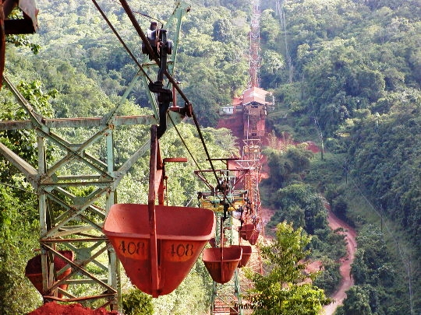
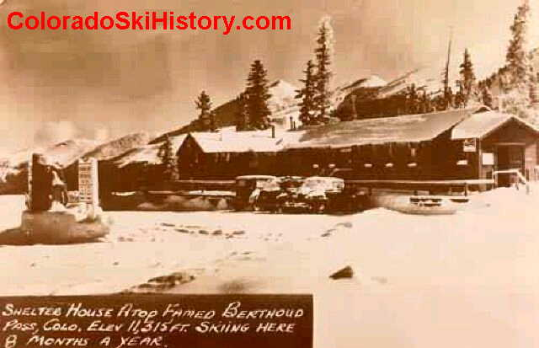
MARKET IMPACTS
PRECIOUS METALS – LATE 1800s
SKIING – POST WWII
Notes:
The ropeway development in North America to date has been comprised of two distinct periods. The first, the use of the ropeway for gold and silver ore transport, had a dramatic impact in the late 1880s but was short lived in its intensity as the price of these metals crashed in the late 1890s.
The second impact period for ropeway technology began in earnest in the 1960s as a means for passenger transport in the developing ski resort industry. Currently there is over 2000 functioning rope systems in North America. For the period 1964 to 2011 approximately 3000 rope systems were installed at resorts in North America.

Slide 9
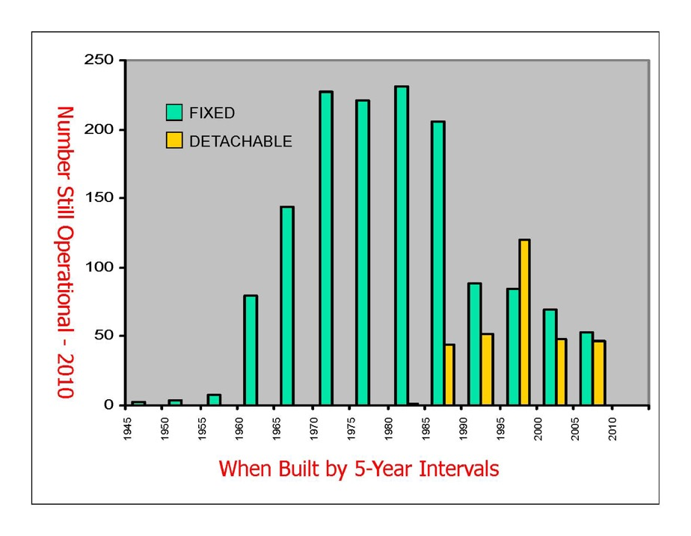
MARKET IMPACTS
SKIING
National Ski Areas Associate, www.nsaa.org Active Tramway Database, Sid Roslund, Technical Director, 133 South Van Gordon St, Suite 300, Lakewood, CO. 80228, (303) 987-1111, sidr@nsaa.org.
Notes:
This figure shows the number of passenger chairlift ropeways that are still being operated, constructed in 5-year intervals since 1945. In considering the ski resort market segment, the future for rope systems lies in replacement of current systems due to obsolescence.

Slide 10
MARKET IMPACTS
AUTOMATED PEOPLE MOVERS
OPERATOR | YEAR BUILT | PASS/DAY | MANUFACTURER
Circus Circus - LV | 1981 | 4000 | SDI
Circus Circus - Reno | 1986 | 6000 | SDI
Mandalay Bay - LV | 1989 | 75000 | DCC
Mirage Treasurer Is | 1994 | 5000 | SDI
Primadonna - NV | 1990 | 5000 | SDI
City Center – LV | 2009 | 10000 | DCC
Mud Island – TN | 1981 | 2000 | SDI
Getty Center – CA | 1997 | 15000 | Otis
Huntsville – AL | 2002 | 2000 | Otis
Table 1 - APM Rope Systems – Leisure & Institutional
Fabian, Lawrence, Airfront.21, www.airfront.us, lfabian@airfront.us
Notes:
Rope propelled people movers made their mark in North American initially in the recreational gaming industry in Nevada in the 1980s. Currently, there are six systems operating in the gaming market in Nevada as detailed in Table 1. In the recreational and institutional markets there are a total of 9 systems operating so it is apparent that the Nevada gaming industry has been a major factor in the development of the rope-propelled people mover with over 100,000 passengers per day.
Based on my empirical analysis, automated people mover systems would not have been utilized in the gaming resorts in Nevada without the economic advantage provided by the rope system when compared to other conventional urban transport.

Slide 11
MARKET IMPACTS
AUTOMATED PEOPLE MOVERS
AIRPORT | YEAR BUILT | PASS/DAY | MANUFACTURER
Cincinnati – OH | 1994 | 35000 | Otis
Detroit - MI | 2002 | 50000 | Otis
Mexico City - Mexico | 2007 | 25000 | DCC
Minneapolis – MN | 2000 | 10000 | Poma-Otis
Minneapolis – MN | 2004 | 7000 | Poma-Otis
Toronto - Canada | 2005 | 25000 | DCC
Birmingham – UK | 2003 | 10000 | DCC
Tokyo – Narita | 1992 | 40000 | Otis
Zurich – SW | 2003 | 30000 | Poma-Otis
Table 2 - APM Rope Systems – Airports
Notes:
Presently there are 26 automated people movers operating at airports in North American with an average daily ridership of 1,100,000. Six of these systems are rope propelled systems with an average daily ridership of 150,000. Worldwide there are 49 systems operating at airports with a total average daily ridership of 1,800,000 including 9 rope-propelled systems with a total daily ridership of 230,000. Table 2 lists the current worldwide applications of rope systems operating at airports.

Slide 12

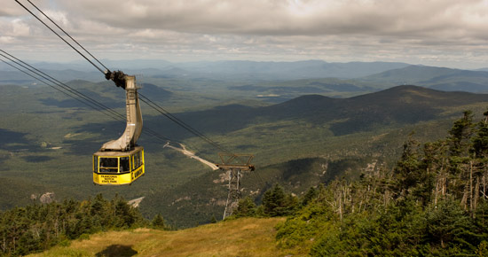
MARKET IMPACTS
AERIAL CABIN ROPEWAYS
Cannon Mountain Tramway
Roosevelt Island Tramway
Notes:
Aerial ropeway systems have been used in various applications outside the ski resort marketplace. In fact before skiing became a commercial venture starting in the late 1930s, gondolas were used in various site-seeing applications in North America. One of the longest operating ropeways for carrying passengers began operation at Niagara Falls, New York in 1916 and operated until 1984 when it was replaced with another ropeway. An early notable ropeway that was used for both skiing in the winter and sightseeing in the summer is the Cannon Mountain, New Hampshire double reversible ropeway completed in 1938.
Several other installations used primarily for sightseeing have been built over the last 50 years. Two notable exceptions include the Roosevelt Island Tramway in New York City and the Portland Aerial Tramway in Portland, Oregon. The Roosevelt Island Tramway is the only aerial ropeway operating in North America that is truly an urban transport system providing convenient daily service for 2,000,000 people yearly between Manhattan and Roosevelt Island located in the East River.

Slide 13
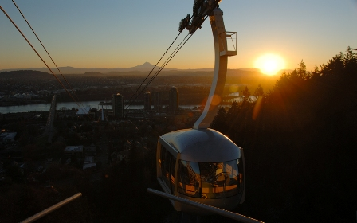
MARKET IMPACTS
AERIAL CABIN ROPEWAYS
Portland Tramway
Notes:
The Portland Aerial Tramway connects two hospital centers of the Oregon Health and Science University (OHSU), one on Marquam Hill with another on the South Waterfront. The tramway allowed the use of marginal land for the expansion of the hospital to provide increased patient, education and research needs with easy access between the two campuses.

Slide 14
BENEFITS
Economic
Safety
Environment
Notes:
The benefits of ropeway transport in North America can be categorized into three areas:
Economic
Safety
Environment

Slide 15
BENEFITS
Economic - Skiing
75,000,000 Skier-Day Visits in North America
$3,000,000,000 Annual Investment Potential
$5,650,000,000 Annual Revenue
Winter Employment – 155,000
Summer Employment – 27,000
Notes:
For the skiing industry in North American, the ropeway and its technological improvements over the last 50 years have been the major economic drivers for the growth of skiing. Today there are approximately 75,000,000 skier-day visits to North American Resorts. Capital depreciation generates cash from skiing operations that could potentially be leveraged into investment of $3,000,000,000 annually. The total revenue from skiing today is approximately $75 per skier day or $5,650,000,000.
Ski resorts in North America employ approximately 155,000 persons during the winter months and 27,000 in the summer months.

Slide 16
BENEFITS
Economic – Automated People Movers
APM Systems - $7M - $25M per Mile
Self-Propelled - $40M - $100M per Mile
Airport Systems N/A – 25% Rope Propelled
Airport Systems World – 18% Rope Propelled
Ridership – 13% - 14% of Airport Systems
Notes:
For the automated people mover industry in North America, the rope-propelled system has provided a much more economical solution for lower capacity systems than the traditional rail technologies. Rope-propelled systems in this industry have been applied from $7,000,000 to $20,000,000 per mile whereas typical rail systems range in cost from $40,000,000 to $100,000,000 per mile for these capacities.
In the airport market the self-propelled systems have historically dominated the market. Currently, 23% of the airport systems operating are rope-propelled systems, but they carry 14% of the riders whereas worldwide at airports 18% of the systems are rope-propelled and carry 13% of the riders. From this it can be seen that the rope-propelled systems service the lower capacity applications.

Slide 17
BENEFITS
Safety
1960 to 2010 - 2,800,000,000 Skier-Day Visits
1960 to 2010 - 18,200,000,000 Passengers
Notes:
When compared to other means of transit in North America, the ropeway has an excellent record. During the period 1960 through 2010 there were approximately 2,800,000,000 skier-day visits to resorts in North America generating approximately 18,200,000,000 rides.

Slide 18
Table 3 – Ropeway Accidents North America
BENEFITS - Safety
LOCATION | DATE | FATALITY | INJURY | COMMENT
Nebraska Fair | 7/65 | 2 | 48 | Gondola-Tower Failure
Raton Pass, NM | 6/68 | 1 | 7 | Chairlift-Rollback
Pomerelle, Idaho | 1/73 |  | 10 | Chairlift-Rollback
Vail, CO | 3/76 | 4 | 5 | Gondola TR Wire
Jiminy Peak, MA | 1/77 |  | 10 | Chairlift Deropement
Hunter Mountain, NY | 1/78 |  | 4 | Chairlift Rollback
Squaw Valley, CA | 4/78 | 4 | 32 | Tram-TR Derope Wind
Heavenly, CA | 4/81 |  | 17 | Chairlift-Deropement
Big Powderhorn, MI | 2/84 | 1 | 8 | Mechanic in BW
Keystone, CO | 12/85 | 2 | 48 | Chairlift-BW Failure
Maple Mtn, MI | 12/89 | 1 |  | Tow-Clothing Caught
Sierra Ski Ranch, CA | 4/93 | 1 | 1 | Grip Caught in Sheave
Whistler, B.C., Canada | 12/95 | 2 | 10 | Chairlift-Grip Detach
Snow Valley, Ont., Can | 12/96 | 1 | 1 | Chairlift Deropement
Lutsen Mtn, MN | 8/00 |  | 6 | Gondola-Grip Failure
Angels Flight, L.A., CA | 2/01 | 1 | 7 | Funicular-Brake Failure
Mt. Sunapee, NH | 12/07 |  | 1 | Chairlift-BW Derope
Blackcome, B.C., Can. | 12/08 |  | 10 | Gondola-Tower Failure
Heavenly, CA | 9/09 | 1 | 1 | Zip Caught Chari
Devils Head, WI | 12/09 |  | 14 | Chairlift-Rollback
Sugarloaf, ME | 12/10 |  | 8 | Chairlift-Deropement
Table 3 – Ropeway Accidents North America
Notes:
From Table 3 – Ropeway Accidents North America, the total fatalities from 1960 through 2010 are 21 for a rate of 0.001154 per million passengers or one for every 900 million passengers. This exceeds safety requirements for automated transit systems where safe is defined as one in 100 million.

Slide 19
BENEFITS - Safety
COMPARISON | FATALITIES | PASS (x10⁶) | RATE | PERIOD
Ropeways | 21 | 18,196 | 0.001154 | 1960-2010
Airlines | 3277 | 19,180 | 0.170100 | 1960-2010
Transit | 5681 | 176,400 | 0.032210 | 1990-2010
Table 4 – Fatality Rate per Million Passengers
COMPARISON | FATALITIES | PASS MILES (x10⁸) | RATE | PERIOD
Ropeways | 21 | 127.4 | 0.1648 | 1960-2010
Airlines | 1482 | 107,170 | 0.0138 | 1991-2010
Transit | 5681 | 8,308 | 0.6840 | 1990-2010
Table 5 – Fatality Rate per 100 Million Passengers Miles
COMPARISON | YEARLY PASS MILES (x10⁶) | AVERAGE # OF FATALITIES/YR. | RATE PER 100 MILLION MILES
Ski Lifts | 224.25 | 0.324 | 0.144
Elevators | 1,360 | 6.000 | 0.441
Automobiles | 2,925,000 | 39,000 | 1.330
Table 6 – Fatality Rate Comparison NSAA
Notes:
The three comparison Tables shown on this slide were developed from data published by the U.S. Federal Aviation Administration, by the U.S. Department of Transportation, by AAA Snow Sports and the National Ski Areas Association.
For transit the modes included in this analysis were Automated Guideway; Commuter Rail; Demand Response; Heavy Rail; Light Rail; Motor Bus and Van Pool.
When considering the number of passengers carried, it is evident that the passenger ropeway is the safest means of travel over the last 50 years

Slide 20
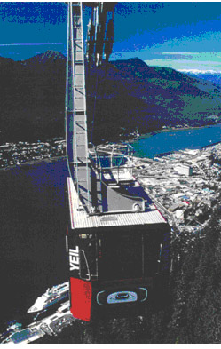
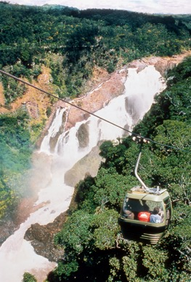
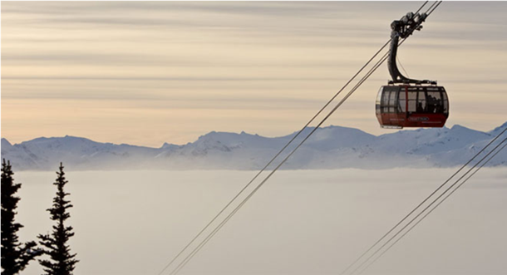
BENEFITS
Environmental
Minimal Infrastructure Along the Alignment
Transportation in Biologically Sensitive Areas
Minimal Use of Resources per Passenger-Mile of Transport
Minimal Visual Impact
Whistler-Blackcomb - CAN
Mt. Roberts - AK
Skyrail Rain Forest
Notes:
The benefits relative to the environmental impacts and sustainability of ropeway transport and its infrastructure have been highlighted in several presentations previously. They include those shown on this slide.

Slide 21
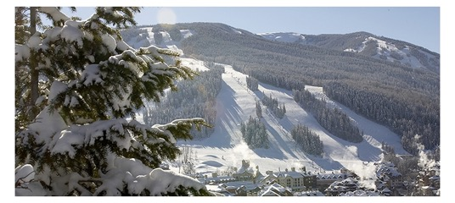
BENEFITS
Environmental
Recycling
Potentially Hazardous Wastes
Fish and Wildlife Management
Forest and Vegetative Management
Wetlands and Riparian Areas
Air Quality
Visual Quality
Transportation
Education and Outreach
Product Re-use
Planning, Design, and Construction
Water Use for Snowmaking
Water Use in Facilities
Water Use for Landscaping and Summer
Water Quality Management
Wastewater Management
Energy Use for Facilities
Energy Use for Snowmaking
Energy Use for Lifts
Energy Use for Vehicle Fleets
Waste Reduction
Notes:
The Environmental Charter subscribed to by skiing resorts in North America promotes sound environmental stewardship and, more importantly, offers a comprehensive set of 21 Environmental Principles that enable ski area operators to make sustainable use of natural resources. The ropeway promotes and allows many of the above principals to be implemented and realized.

Slide 22
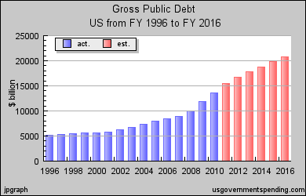
OUTLOOK
Overall Economy
Notes:
The outlook for the next 25 years has to be viewed through the larger glasses of the overall economy. The five-year outlook relative to the economy in North America is not positive. Considering the current US debt burden and its deficit growth over the last few years and the inability of the government to deal with the issue, investment most likely will be constrained on the public side and the flow of credit will affect the private side.

Slide 23
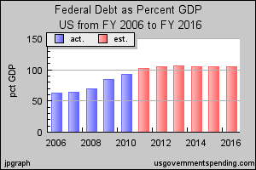
OUTLOOK
Overall Economy
Notes:
Given the stormy outlook for the overall economy in North America, the malaise will eventually end and growth will accelerate sometime between 2017 and 2020. The good news that counters the profligacy of our federal and state governments in the United States and their current financial condition is the fact that the private sector business have been making money and conserving cash including the ski and gaming resort operators. If they can sustain their current financial condition for the next five years, then their investments will be able to drive the ropeway industry in North America. Further, it appears that airports, the largest user of automated people movers is also in a good position for growth when the economy rebounds.

Slide 24
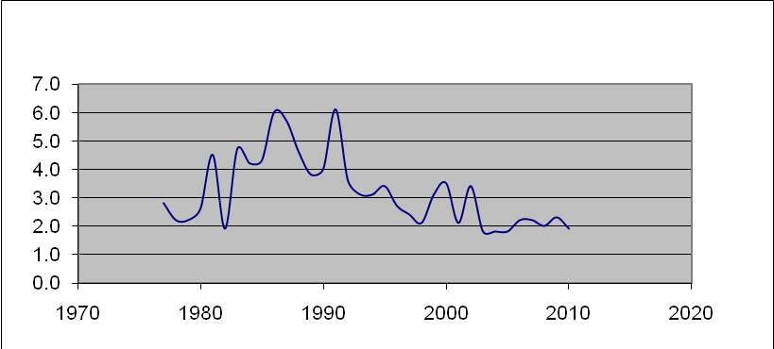
OUTLOOK
Ski Resort Health
DEBT/EBITD
Notes:
Currently the health of the ski resort operator is good even though the overall economy in North America has not done well since 2008. This chart shows the ratio of debt to EBITD (earnings before interest, taxes and depreciation) from 1977 through 2010.
As can be seen this ratio has been trending down since 1990 with an acceptable ratio of 2.0 or less which means that resorts have strong balance sheets that will drive investment.

Slide 25
OUTLOOK
Recreational Ropeway Potential Investment
Capital Expenditure 2004-2011 - $437,700,000
Seven Year Average - $62,500,000
Annual Required VTFH Replacement - 200,000
Average Cost per VTFH - $1,050
Required Investment – $210,000,000
Total Potential Resort Investment - $3,000,000,000
Notes:
Further, considering that a significant amount of equipment currently being operated is older than 25 years the environment both on the supply side, cash for investment, and the demand side, the need for modernization, is excellent for expansion of the ropeway industry in North America. The capital expenditures for ropeway equipment in the United States since 2004 have totaled $437,700,000 for an average over the seven years of $62,500,000.
Additionally, this required annual investment of $210,000,000 is well within the capability of ski resort financing yielding $3,000,000,000 in available total investment capital.

Slide 26

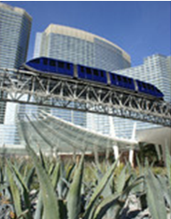
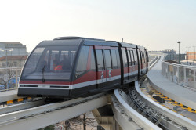
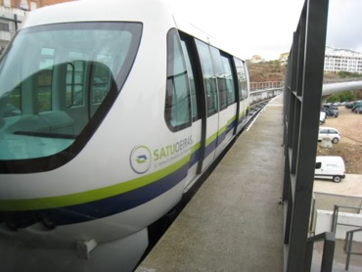
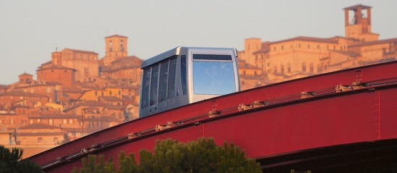
OUTLOOK
Ropeway APM Potential Investment
One Airport System since 2005 – Mexico City by DCC
Six Airport Systems – 2000 through 2005
City Center Las Vegas – 10,000 passengers per day
Oerias Lisbon – 1000 passengers per day
Perugia Italy – 30,000 passengers per day
Venice – Transit Link
Mexico City
City Center
Venice
Lisbon
Perugia
Notes:
Considering the airport market for ropeway systems over the last six years does not give one a good feeling about what the next 5 or 10 years might bring. Since 2005 there has been one ropeway system built at an airport worldwide, in Mexico City, although there are currently two under construction in Cairo and Doha compared to the period from 2000 through 2005 where six airport systems were built worldwide.
Larger institutional rope-propelled APMs have been installed since 2005, one at City Center in Las Vegas transporting 10,000 passengers per day; one at Oerias in Lisbon, 1000 passenger per day; and one in Perugia, Italy, 30,000 passengers per day. Additionally, an urban rope system was implemented in Venice, Italy.

Slide 27
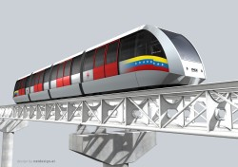
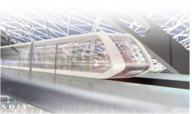
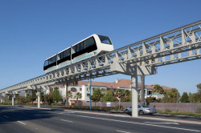
OUTLOOK
Ropeway APM Potential Investment
Doha
Caracas
Oakland
Notes:
There are two major rope-propelled projects currently being implemented, one in Caracas totaling $75,000,000 in system equipment and one in Oakland totaling $100,000,000.
Given the above history during the last six years and the uncertain economic climate over the next 5 to 10 years it is problematic that much growth will be experienced in the ropeway markets in North America. When the economic conditions dictate, the ropeway will present a cost effective solution for both the airport and leisure markets.

Slide 28
CONCLUSIONS
Ropeways Have Provided the Safest Means of Public Transport for the last 50 years.
Last 50 Years – 18,000,000,000 Passengers
Annual Ropeway Transport – 500,000,000
Resort Market Investment - $250,000,000
www.engineeringspecialtiesgroup.com
Notes:
The ropeway has a long and varied history in its application in North American. When applied using state-of-the-art engineering and manufacturing principals, ropeways have provided safe and reliable transportation. Ropeway systems in North America have transported more than 18 billion passengers during the last 50 years! Currently the ropeway systems in North American transport annually 1.5 times the total population of North America, excluding Mexico!
The investment capital available to forestall the obsolescence of ropeway equipment in the very mature ski resort market is adequate. The resort balance sheet is healthy and can take on this investment. Investments between $200,000,000 and $250,000,000 annually will be required. A more critical factor is the capacity of the manufacturing sector to respond. The general economic conditions will stymie this investment for at least the next 5 years. The APM market for ropeway systems being less mature than the resort ropeway market does not provide as much clarity as to the future.
Please download my complete research paper at: www.engineeringspecialtiesgroup.com

