Slide 1
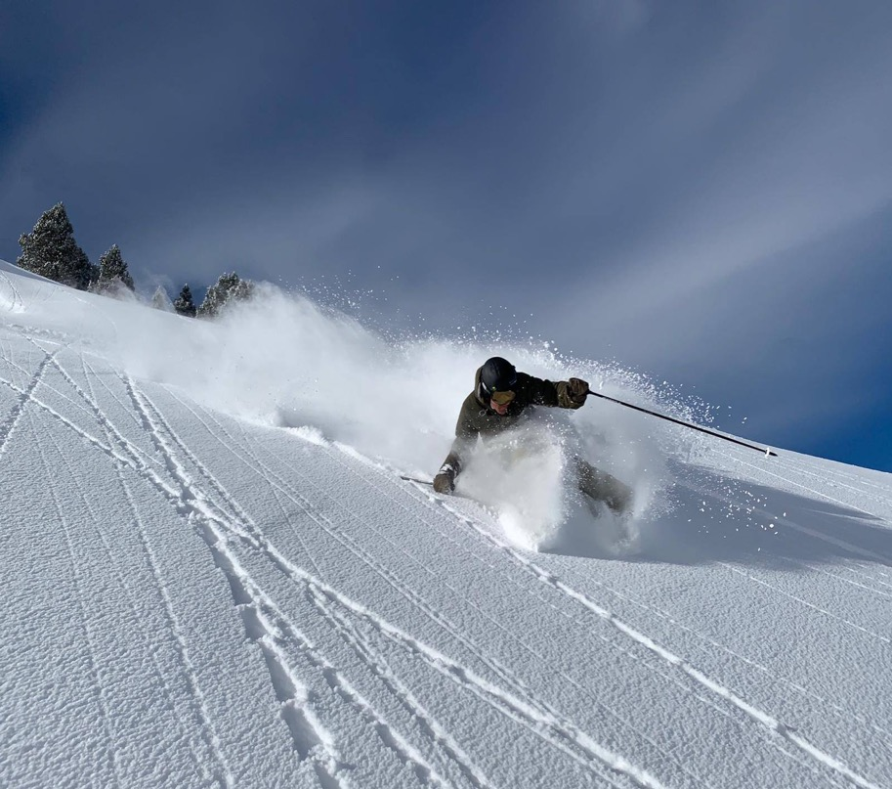

European
OITAF Seminar 2019
Congress Innsbruck May 9, 2019
Ropeway Statistics
Joaquim Alsina
(Associació Catalana d'Estacions d'Esquí i Activitats de Muntanya)
Notes:
Good morning everybody, thanks to all of you to for being here. First of all thanks to Mr. Jörg SCHRÖTTNER for giving me the opportunity to share with you the evolution of the ski industry.

Slide 2
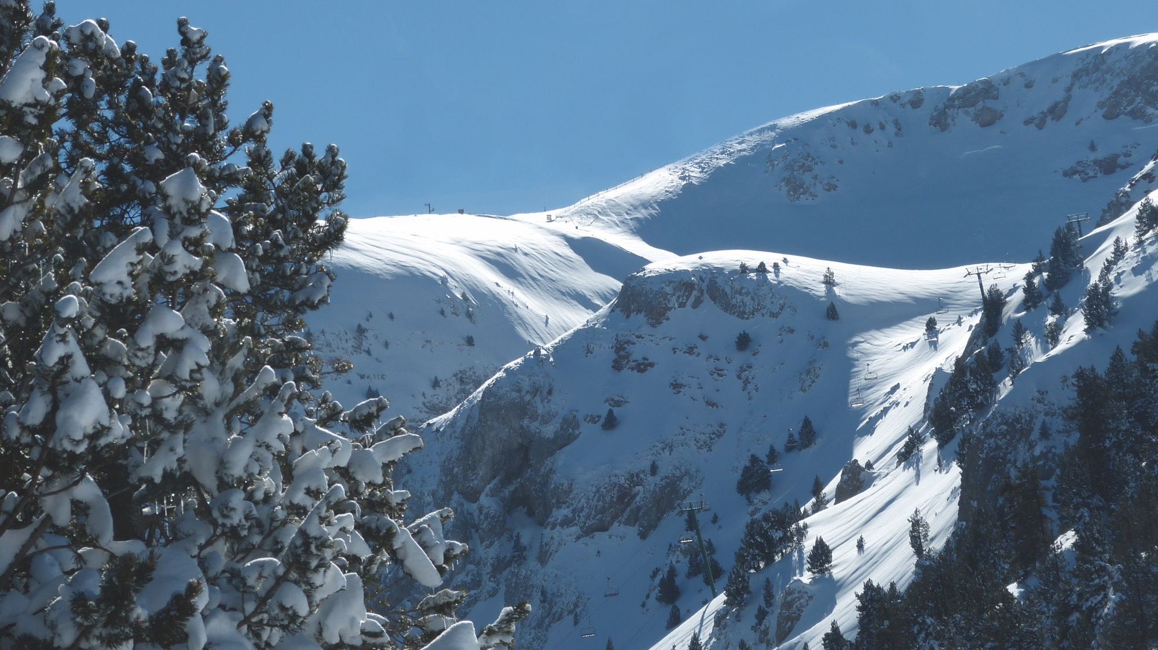

European
Ropeway Statistics
Andorre
Austria
Finland
France
Germany
Italy
Norway
Slovenia
Spain
Sweden
Switzerland
Members Statistics
International Federation of National Cable, Funicular and Other Cable Transport Operator Associations for Passengers
What I want to share with you:
Some information about the frequency of visits to ski resorts and about net sales of ski lift passes.
Notes:
Let me start with a few words about FIANET.
Exchange of information, analysis of the new regulations that affect the sector: transport, environment, energy, etc. and its impact on ski resorts, learn from everyone's experience.

Slide 3
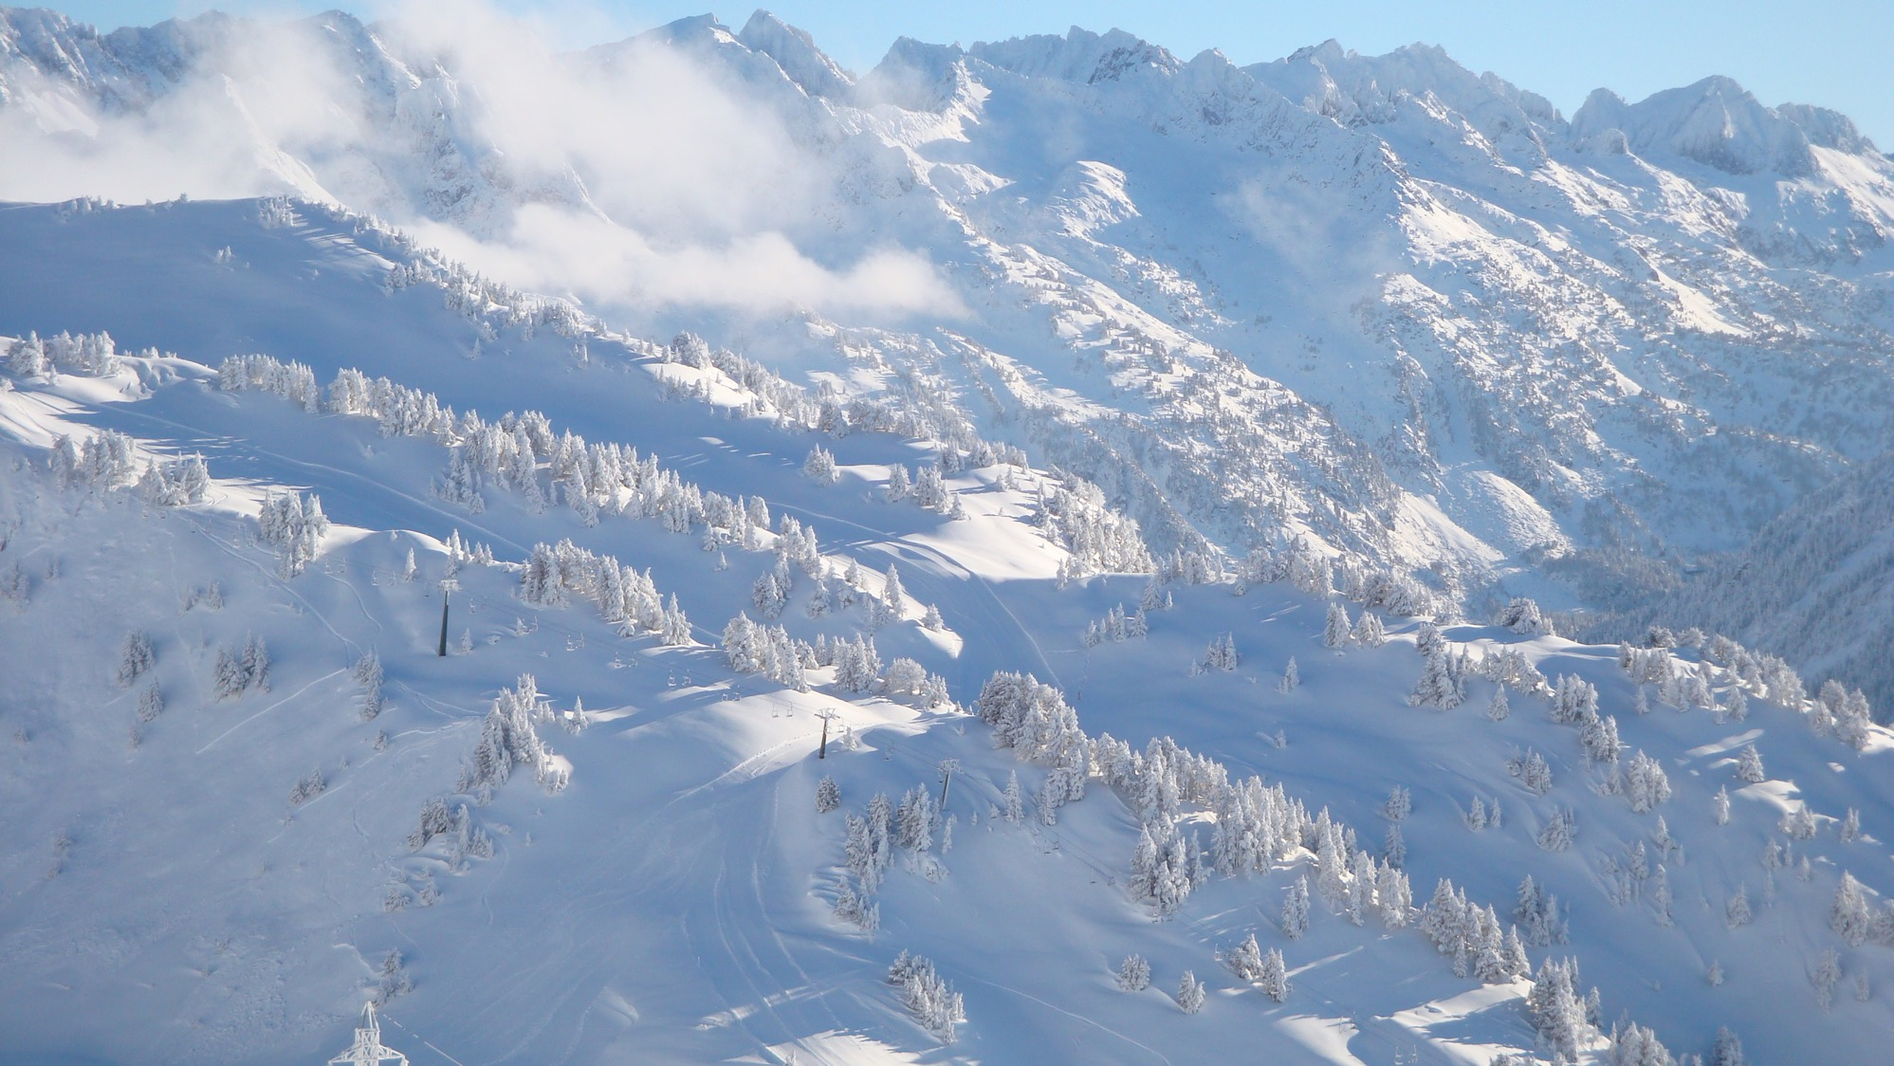

Members Statistics
Some information about the frequency of visits to ski resorts in recent seasons.
which data ?
Skier visits (or skier-days): One person visiting a ski area for all or any part of a day or night for the purpose of skiing, snowboarding, or other downhill sliding activity. Skier visits include full-day, half-day, night, complimentary, adult, child, season pass and any other type of ticket that gives a skier/snowboarder the use of an area's facilities. A skier skiing for a whole week at a resort accounts for 7 skier visits (for example).
Laurent Vanat. International Report on Snow & Mountain Tourism
Net sales: Ski resorts income for the sale of ski passes.
Any other income they may have for the provision of other services is excluded.

Slide 4
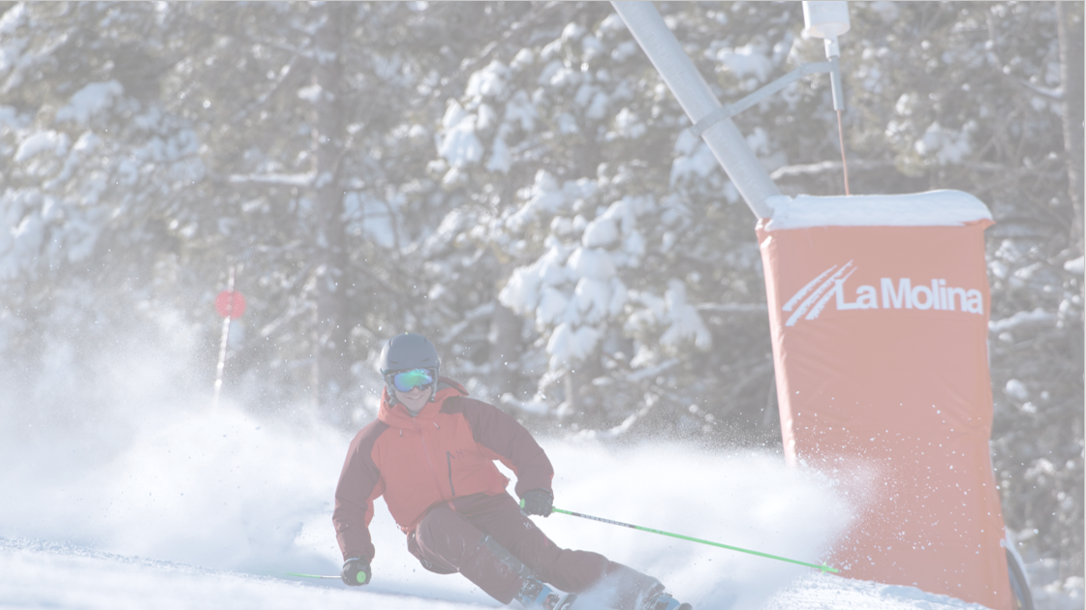
Members Statistics
Some information about the frequency of visits to ski resorts in recent seasons.
which period ?
From season 2005-2006 until season 2017-2018 for skier-days.
From season 2008-2009 until season 2017-2018 for net sales.
which sources ?
All FIANET members for skier-days and for net sales.
Notes:
The challenges of data collection, we started with just one data type: skier-days; tree years later we ask for the net sales.
Each country is responsible for the quality of its information

Slide 5
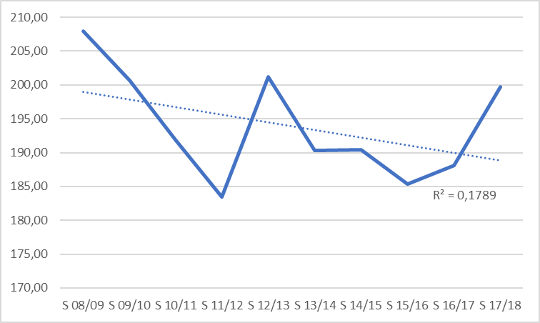
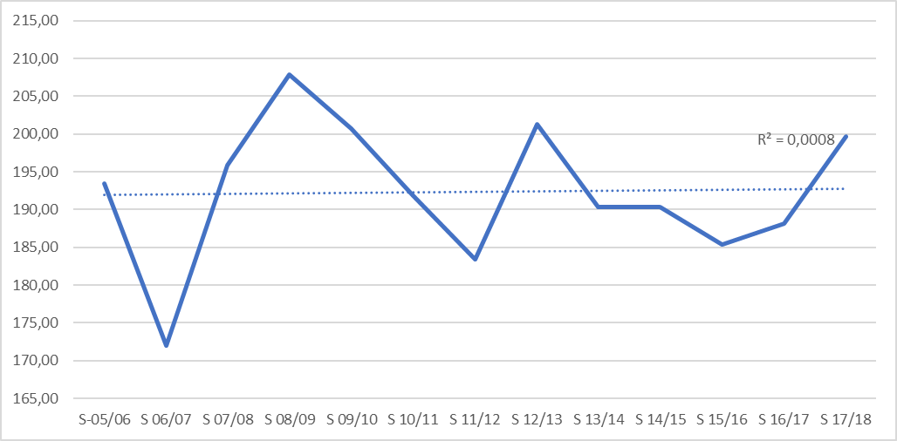
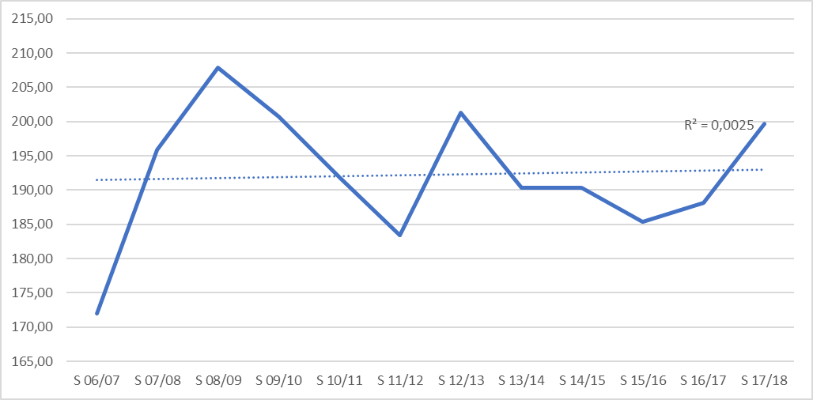
Members Statistics
Some previous comments
Graphics
What period do we choose
We have information of this period: 13 seasons
10 seasons from 2008-2007 to 2017-2019
we have gone down 3,94%
13 seasons from 2005-2006 to 2017-2018
we have gone up 3.25%
12 seasons from 2006-2007 to 2017-2018
we have gone up 16.13%
Notes:
We have information about 13 seasons. Actually 13 sounds like a bad number.
First, we test with 10 and we obtain a very pessimistic view of the evolution of the sector, is it real?.
Then, we test with 12 and now we get a vision that is too optimistic at the same time.
Our conclusion: always use the longest available period to obtain a more realistic vision

Slide 6
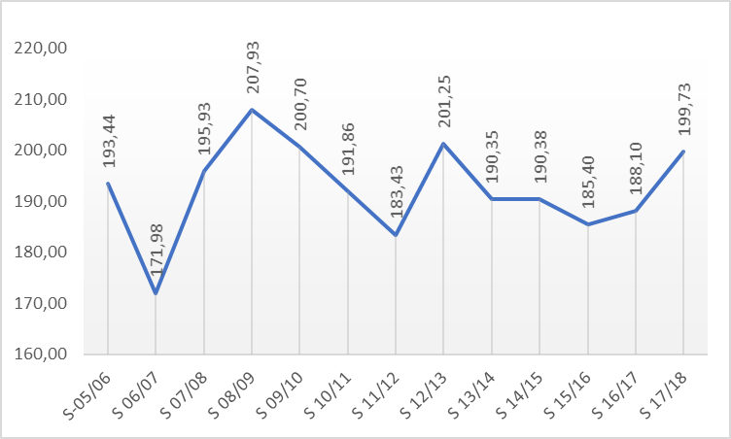
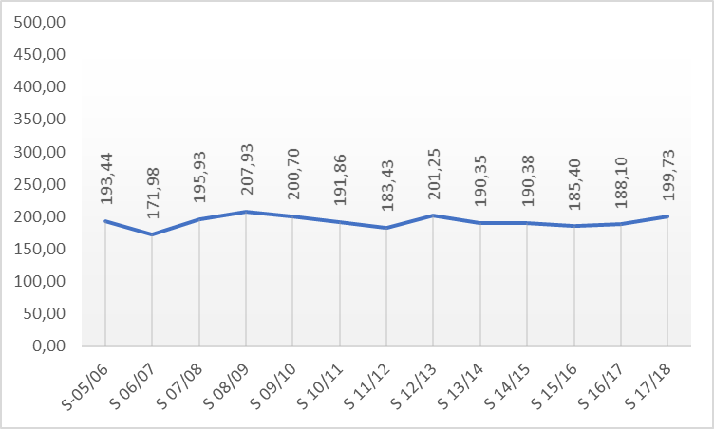
Members Statistics
Some previous comments
Graphics
What scale do we choose
Vertical axis close to min and max values
shows very irregular behavior
Vertical axis far away from min and max values
shows a more stable behavior
Notes:
the vertical axis of a graphic can totally change the image that we convey of the evolution of an information.

Slide 7
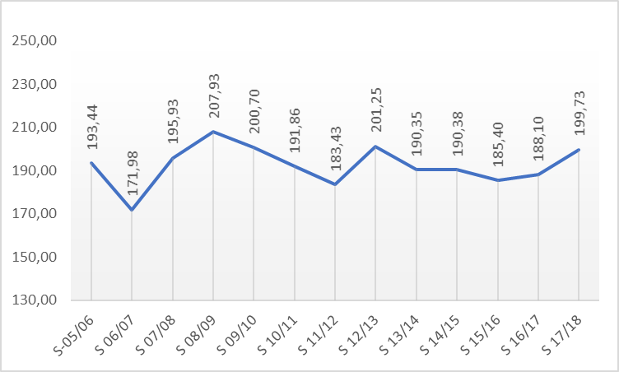
FINET
Members Statistics
Some information about the frequency of visits to ski resorts in recent seasons.
All countries
Skier-days evolution. From 2005-2006 to 2017-2018
Notes:
This slide shows the real evolution of skier-days during the period

Slide 8
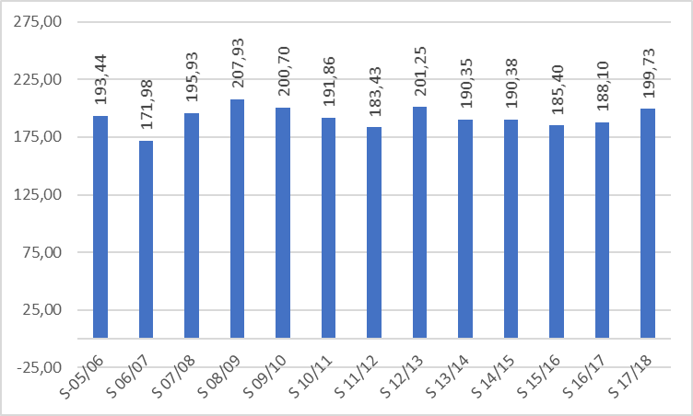
Members Statistics
Some information about the frequency of visits to ski resorts in recent seasons.
All countries
Skier-days evolution. From 2005-2006 to 2017-2018
Notes:
The best season: 2008-2009 195.93 Skier-days
the worst season: 2006-2007 171,98 Skier days
the last season: 2017-2018 199,73 Skier-days

Slide 9
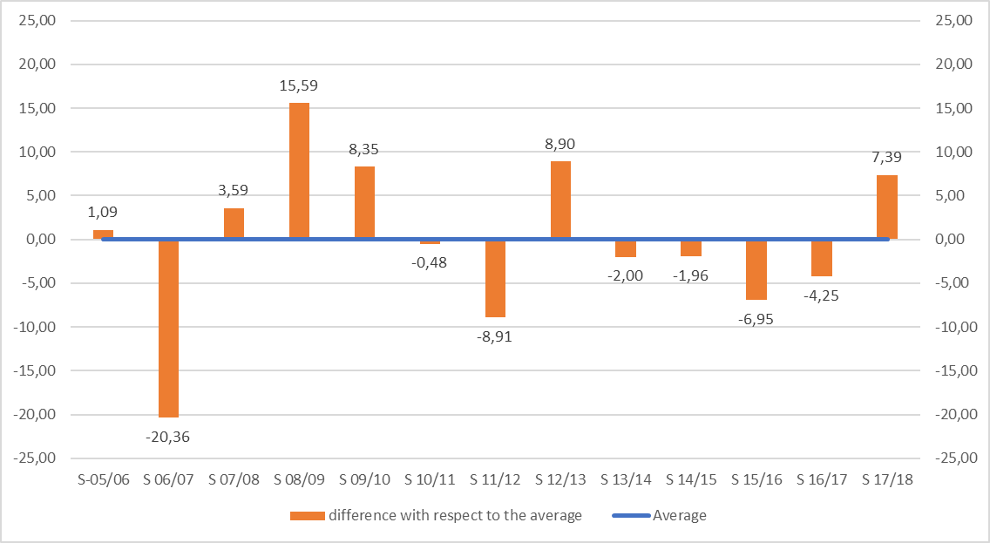
Members Statistics
Some information about the frequency of visits to ski resorts in recent seasons.
All countries
Differences from the average (192,34 M skier-days)
Notes:
Here we can observe the deviation from the average of each season

Slide 10
Members Statistics
Some information about the frequency of visits to ski resorts in recent seasons.
Notes:
Here we can see the details for each country and each season

Slide 11
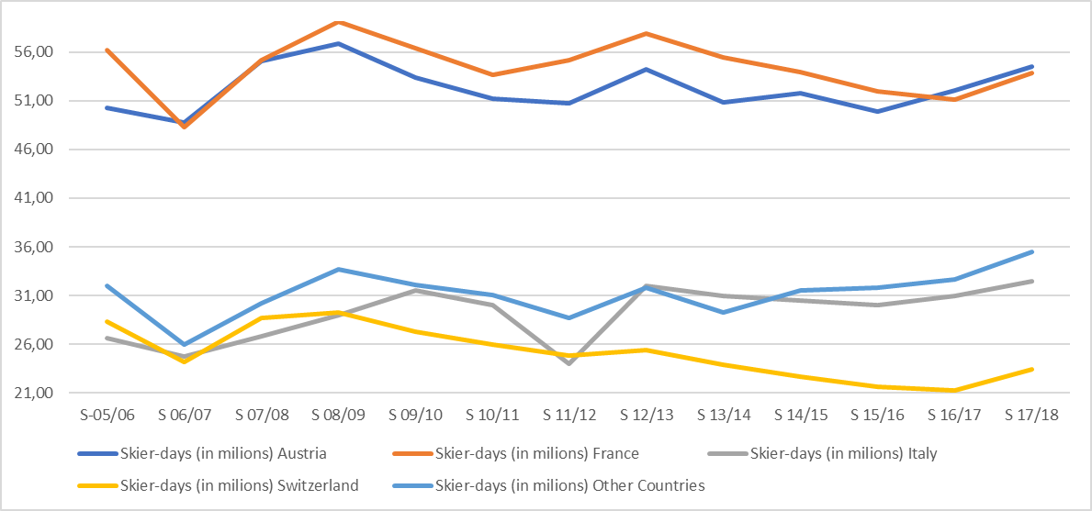
Members Statistics
Some information about the frequency of visits to ski resorts in recent seasons.
The big ones and the others
Skier-days evolution
Notes:
We can distinguish two groups of countries according to the number of skier-days, those that are above 20 million and those that are below.
Here we see the evolution of the big four and that of the sum of the other countries.
You can observe the changes in the positions of the countries; Austria-France and Italy-Switzerland

Slide 12
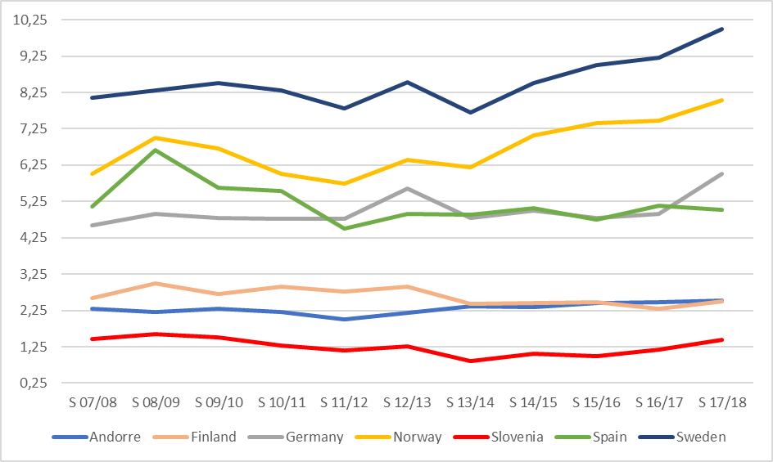
Members Statistics
Some information about the frequency of visits to ski resorts in recent seasons.
The small ones
Skier-days evolution
Notes:
Here we see the evolution of the small countries according to the number of skier-days,
some countries have maintained their positions and others have exchanged them.

Slide 13
Members Statistics
Some information about the frequency of visits to ski resorts in recent seasons.
Notes:
This table shows detailed by countries the evolution of skier-days between seasons.
It is not risky to see the influence of meteo (weather conditions?).

Slide 14
Members Statistics
Some information about the frequency of visits to ski resorts in recent seasons.
Notes:
Here we can see the evolution of skier-days from the first station we have information to the last.
Seven countries had more skier-days on season 2017-2018 than in season 2005-2006.
Be carefully with percentages, 43.39% for Norway means 2,43 millions more of skier-days, 8,35% for Austria means 4,20 millions.

Slide 15
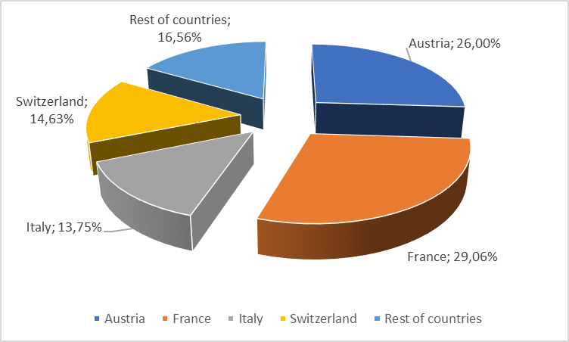
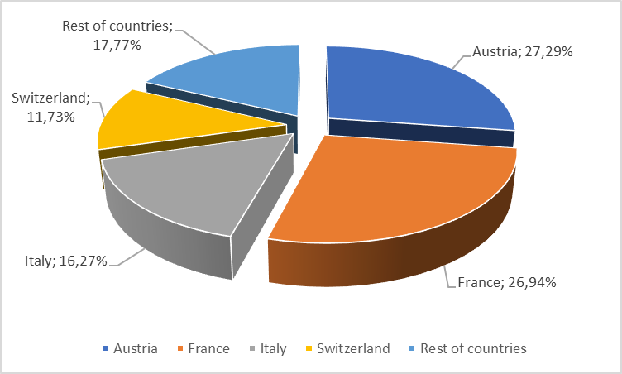
Members Statistics
Some information about the frequency of visits to ski resorts in recent seasons.
who is who
Marquet share
who is who
Market share: The big ones
Season 2005-2006
Season 2017-2018
Notes:
How has the distribution of the cake changed in 13 seasons?
The little ones grow a bit, Austria and Italy grow a little bit more and France and Switzerland lose a bit.

Slide 16
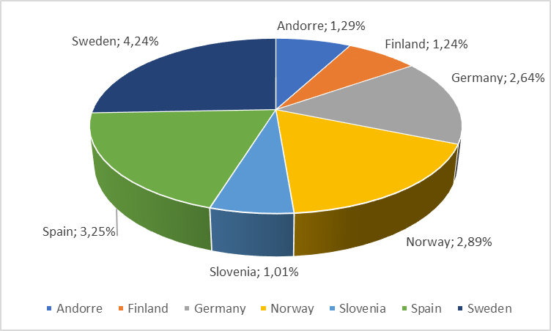
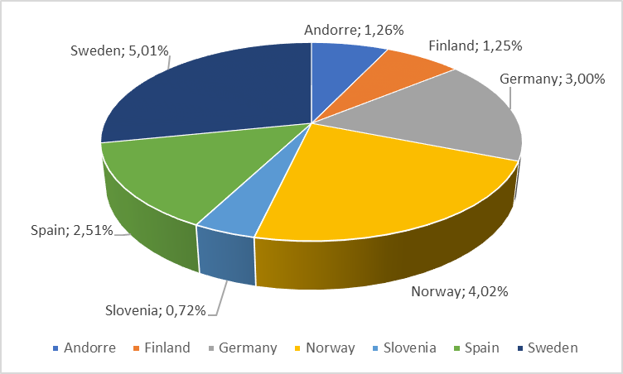
Members Statistics
Some information about the frequency of visits to ski resorts in recent seasons.
who is who
Marquet share
who is who
Marquet share: the small ones
Season 2005-2006
Season 2017-2018
Notes:
How has the distribution of the cake changed in 13 seasons
Here Germany, Norway and Sweden go up and the rest go down.

Slide 17
Members Statistics
Some information about the frequency of visits to ski resorts in recent seasons.
Notes:
Here we have the detailed market share for countries and seasons

Slide 18
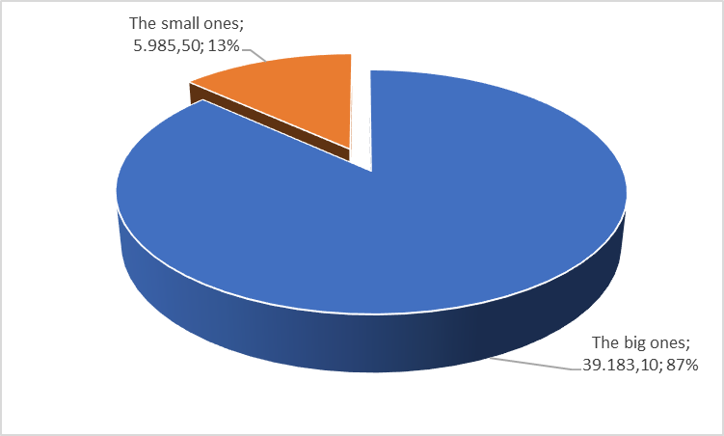
Members Statistics
Some information about net sales of ski lift passes
Net sales
Last 10 seasons: 45.168,60 M€
Net sales with inflation
Currency exchange rates from EUROSTAT
Inflation rates from EUROSTAT
http://appsso.eurostat.ec.europa.eu/nui/show.do?dataset=ert_bil_eur_a&lang=en
http://ec.europa.eu/eurostat/tgm/refreshTableAction.do?tab=table&plugin=1&pcode=tec00118&language=en
Notes:
Let’s continue now with the sales figures. As we have said previously we only have information about 10 seasons.
Four countries receive 87% and the other 11 receive 3%

Slide 19
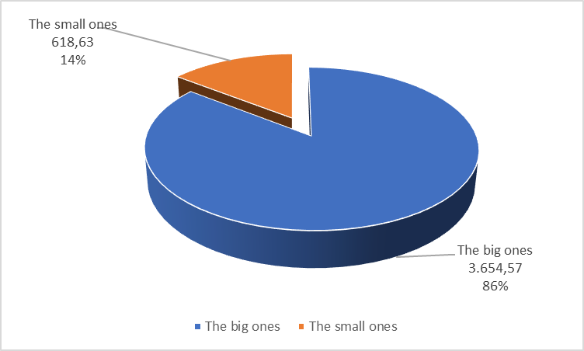
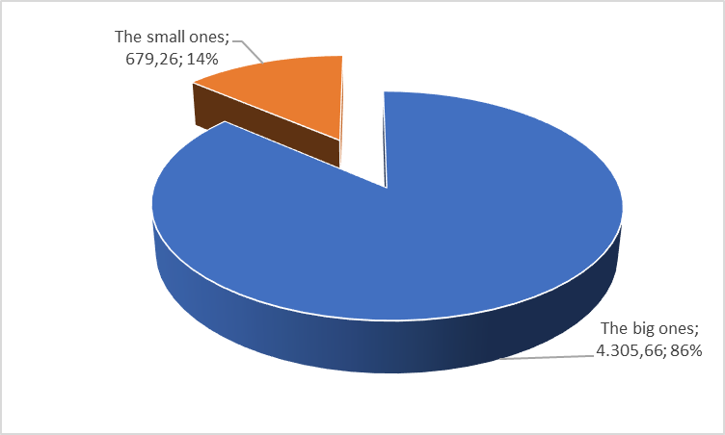
Members Statistics
Some information about net sales of ski lift passes
Net sales
Season 2008 – 2009: 4273,20 M€
Season 2017 – 2018: 4984,92 M€
Net sales with inflation
Currency exchange rates from EUROSTAT
Inflation rates from EUROSTAT
http://appsso.eurostat.ec.europa.eu/nui/show.do?dataset=ert_bil_eur_a&lang=en
http://ec.europa.eu/eurostat/tgm/refreshTableAction.do?tab=table&plugin=1&pcode=tec00118&language=en
Notes:
Greater amounts but the same distribution.

Slide 20
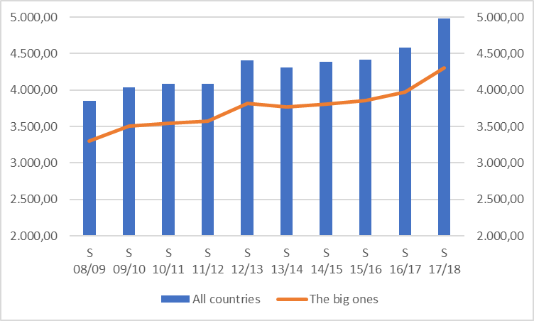
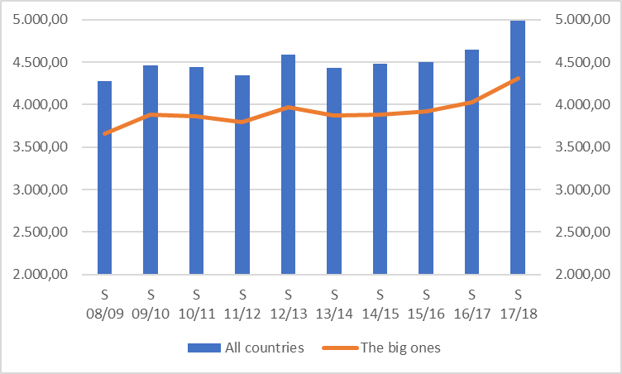
Members Statistics
Some information about net sales of ski lift passes
Net Sales
The big ones & all countries
Net sales without inflation
Net sales with inflation
Currency exchange rates from EUROSTAT
Inflation rates from EUROSTAT
http://appsso.eurostat.ec.europa.eu/nui/show.do?dataset=ert_bil_eur_a&lang=en
http://ec.europa.eu/eurostat/tgm/refreshTableAction.do?tab=table&plugin=1&pcode=tec00118&language=en
Notes:
We can see the evolution of the total number of countries and the evolution of the big four, without taking into account inflation on the left and with inflation on the right.

Slide 21
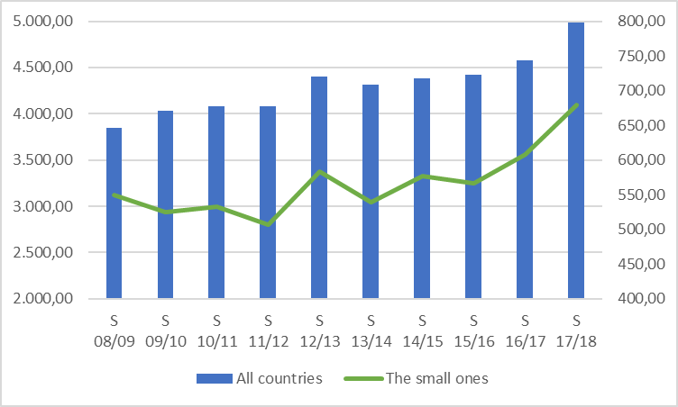
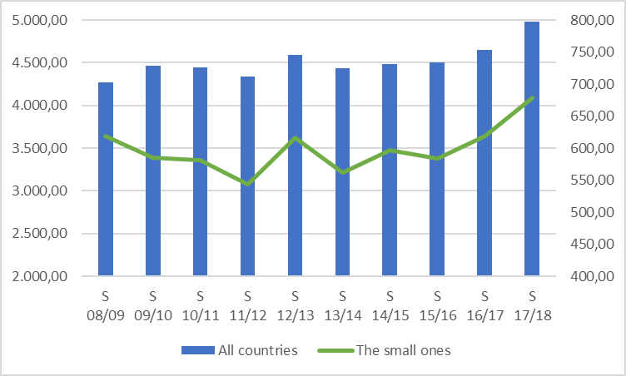
Members Statistics
Some information about net sales of ski lift passes
Net Sales
The small ones & all countries
Net sales without inflation
Net sales with inflation
Currency exchange rates from EUROSTAT
Inflation rates from EUROSTAT
http://appsso.eurostat.ec.europa.eu/nui/show.do?dataset=ert_bil_eur_a&lang=en
http://ec.europa.eu/eurostat/tgm/refreshTableAction.do?tab=table&plugin=1&pcode=tec00118&language=en
Notes:
We can see the evolution of the total number of countries and the evolution of small countries, without taking into account inflation on the left and inflation on the right.

Slide 22
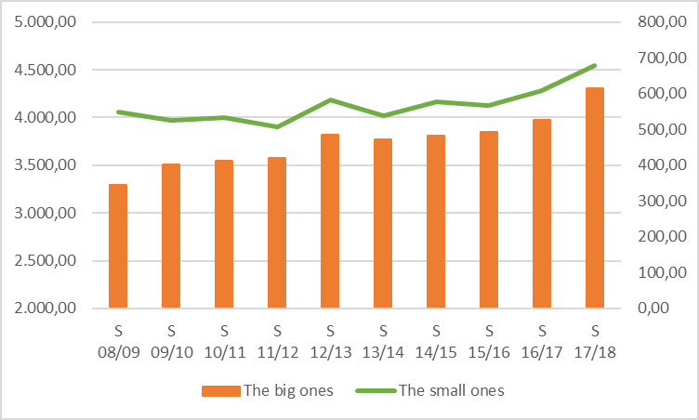
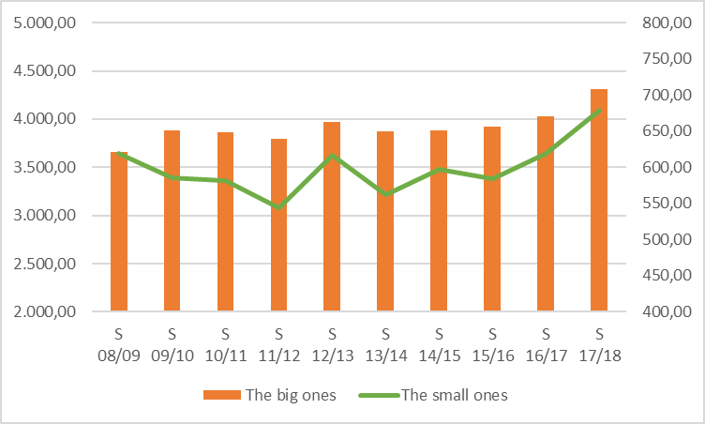
Members Statistics
Some information about net sales of ski lift passes
Net Sales
The big ones & the small ones
Net sales without inflation
Net sales with inflation
Currency exchange rates from EUROSTAT
Inflation rates from EUROSTAT
http://appsso.eurostat.ec.europa.eu/nui/show.do?dataset=ert_bil_eur_a&lang=en
http://ec.europa.eu/eurostat/tgm/refreshTableAction.do?tab=table&plugin=1&pcode=tec00118&language=en
Notes:
We see the evolution of the big four and the evolution of small countries, without taking into account inflation on the left and inflation on the right.

Slide 23
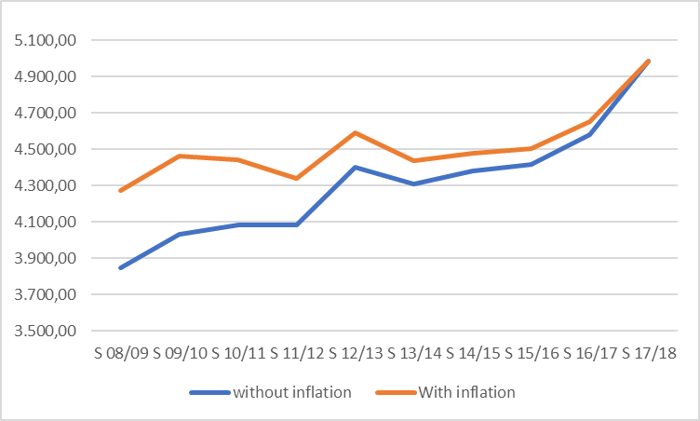
Members Statistics
Some information about net sales of ski lift passes
Net Sales
All countries
Currency exchange rates from EUROSTAT
Inflation rates from EUROSTAT
http://appsso.eurostat.ec.europa.eu/nui/show.do?dataset=ert_bil_eur_a&lang=en
http://ec.europa.eu/eurostat/tgm/refreshTableAction.do?tab=table&plugin=1&pcode=tec00118&language=en
Notes:
We see here the evolution of sales without and with inflation.
The impact of inflation in the initial season is 425,84 M€

Slide 24
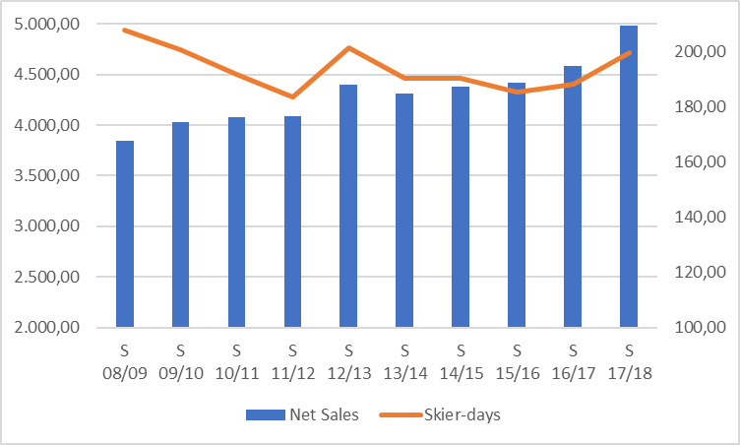
Members Statistics
Some information about net sales of ski lift passes
Evolution of skier-days and net sales
Net sales without inflation
Notes:
Have ski days evolved the same as billing? Here we present the information without considering inflation.

Slide 25
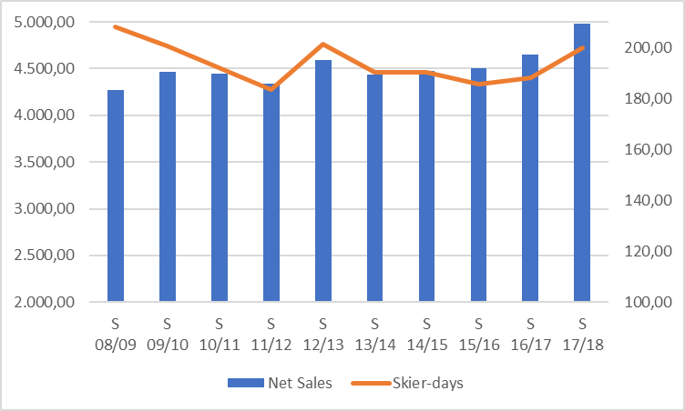
Members Statistics
Some information about net sales of ski lift passes
Evolution of skier-days and net sales
Net sales with inflation
Currency exchange rates from EUROSTAT
Inflation rates from EUROSTAT
http://appsso.eurostat.ec.europa.eu/nui/show.do?dataset=ert_bil_eur_a&lang=en
http://ec.europa.eu/eurostat/tgm/refreshTableAction.do?tab=table&plugin=1&pcode=tec00118&language=en
Notes:
To continue with the same comparation but with inflation.

Slide 26
European
Ropeway Statistics
Any smile after too many figures?
There are lies, damned lies and statistics
It is easy to lie with statistics. But it is easier to lie without them.
Some people use statistics like drunk people use streetlights:
to hold on instead of to enlighten

Slide 27
OITAF Seminar 2019
Congress Innsbruck May 9, 2019
Thanks for your attention
jalsina@catneu.net
ACEM
(Associació Catalana d'Estacions d'Esquí i Activitats de Muntanya)

