Slide 1
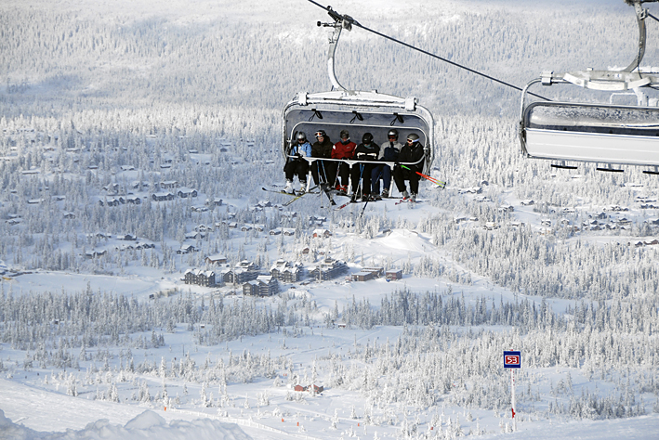
O.I.T.A.F. 27th of June 2008
”ECONOMIC IMPORTANCE OF ROPEWAY INSTALLATIONS AS MEANS OF CONVEYANCES SUPPORTING THE DEVELOPMENT OF WINTER TOURISM AS SHOWN BY THE EXAMPLE OF TRYSIL” – Bo Halvardsson, CTO, SkiStar AB.

Slide 2
Disposition
Worldwide
Scandinavia
Norway
Case Trysil

Slide 3
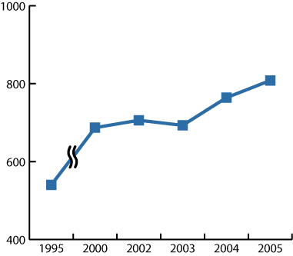
Tourism industry
According to UNWTO the global tourism has increased by 45% during the last 10 years.

Slide 4
Alpine ski market – worldwide
Nordic, 4% (Sverige 1.8%, Norge 1.4%, Finland 0.7%)
Others, 29%
The Alps, 46%
North America, 21%

Slide 5
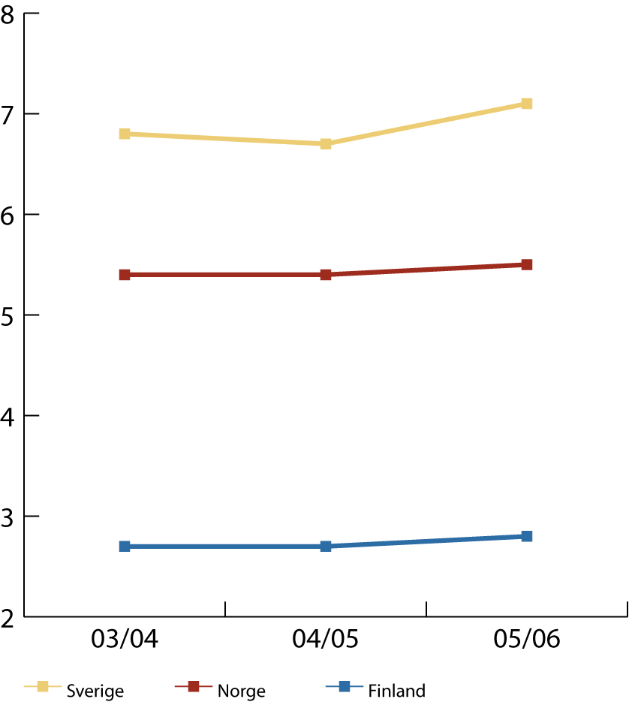
Skier days in Scandinavia
Antall skidager i millioner
Total 15,4 million skierdays

Slide 6
Alpine tourism Norway
The twelve largest destinations have increased the lift ticket turnover with 170% since 91/92
Total turnover in lift tickets 06/07 was 732 mill. NOK (91,5 mill EUROS)
Yearly investment in lifts and snow making is 300 mill. NOK (37,5 mill. EUROS)
The alpine areas generates totally turnover in mountain region close to 4 billion NOK (500 mill EUROS)

Slide 7
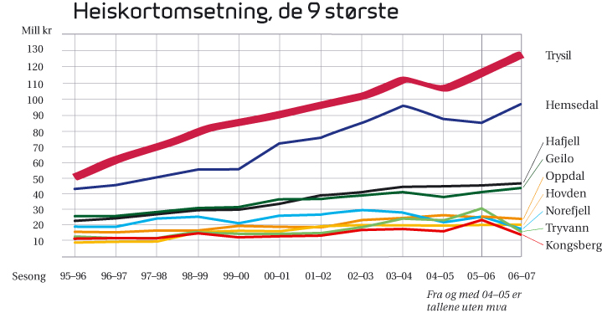
Lift ticket turnover – 9 largest in Norway

Slide 8
Commercial guest nights in the mountain region
1 580 000 Norwegians
1 350 000 foreigners
2 930 000
Tall fra SSB og Alpinanleggenes Landsforenings beregninger

Slide 9
Visitor statistic
Trysilfjellet is Norways largest tourist attraction with 798 000 visitors
Holmenkollen Oslo is No 2 with 650 000, Hemsedal No 3 with 590 000 before Dyreparken Kristiansand with 560 000.
Numbers from Innovasjon Norge/Alpinanleggenes Landsforening.

Slide 10
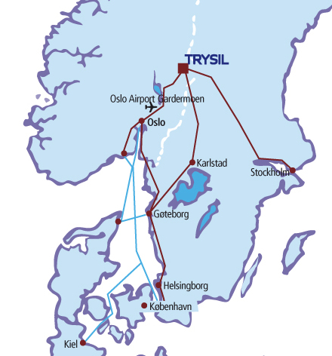
Where is Trysil located?
Oslo Airport Gardermoen 160 km
Oslo 210 km
Stockholm 470 km
Gothenburg 500 km
Copenhagen 770 km

Slide 11
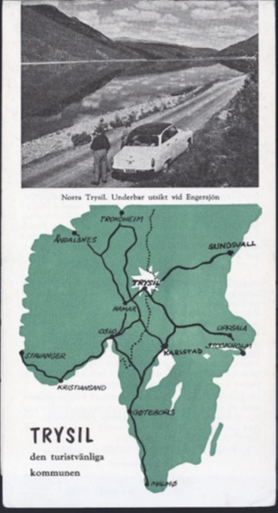
Welcome to Trysil
The first tourist brochure

Slide 12
Important industries in Trysil
Forest
Agriculture
Production
Tourism

Slide 13
”- planning large revenues from the tourism industry is ridicolous and should not be recommended”
”På den annen side ligger bygda noe utenom allfarvei, hvis man kan si det på den måten.
Den faller ikke lett i turistenes øyne, det kan være tungvint å komme dit, og ikke alt for mange vet noe større om den.”
” Konklusjonen må bli: Bygda har mye å by turistene, men er på mange måter handicaped i konkurransen. Å regne med veldige inntekter av næringen er virkelighetsfjernt og bør frarådes”
From article in local newspaper Østlendingen 1956

Slide 14
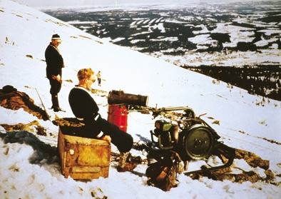
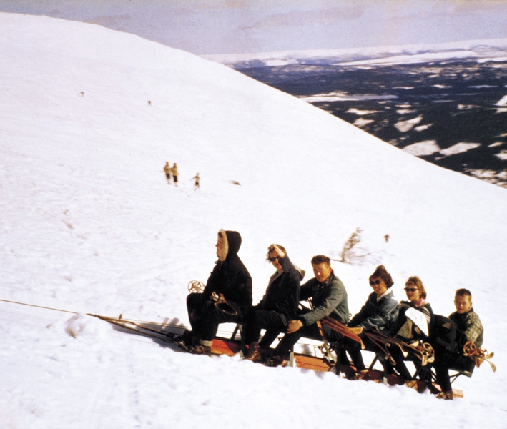
Trysils first six-seater – 1950´s

Slide 15
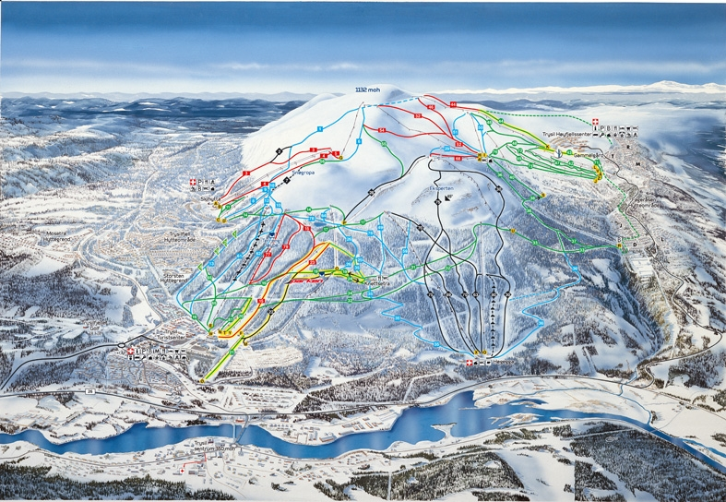
Trysilfjellet – the first professional ski lift came in 1966

Slide 16
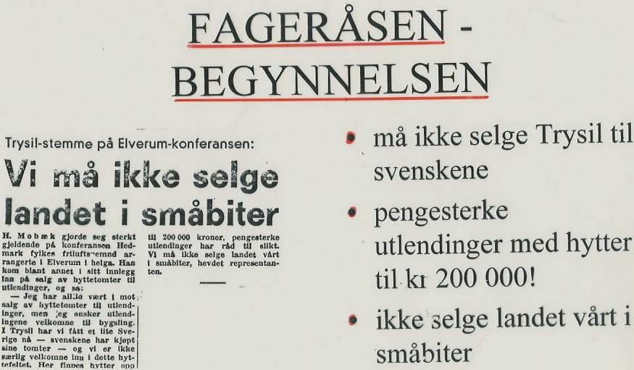

Slide 17
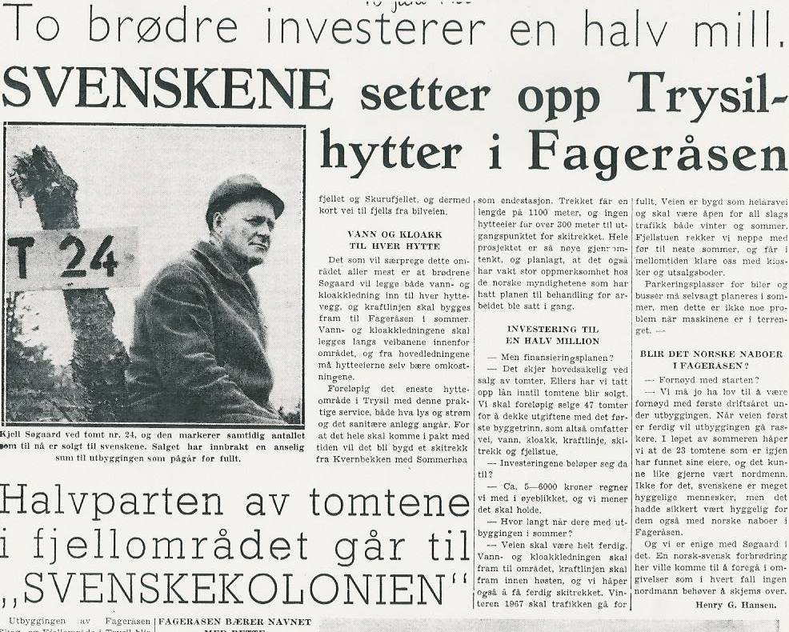

Slide 18
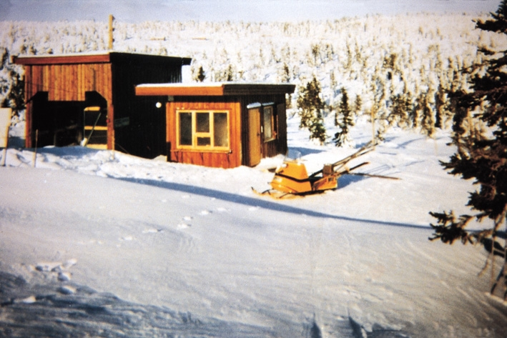
The first Welcome Center - 1966

Slide 19
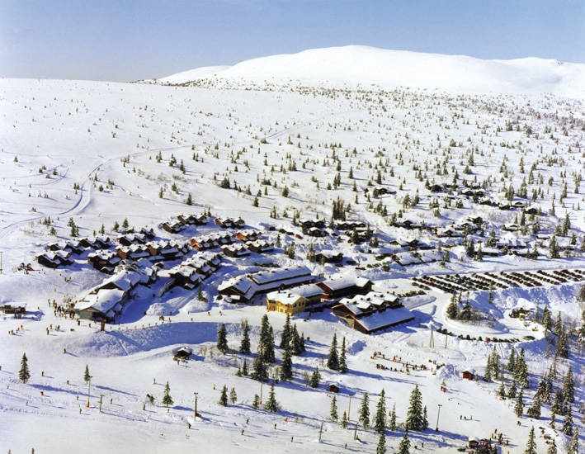
Same area 40 years later

Slide 20
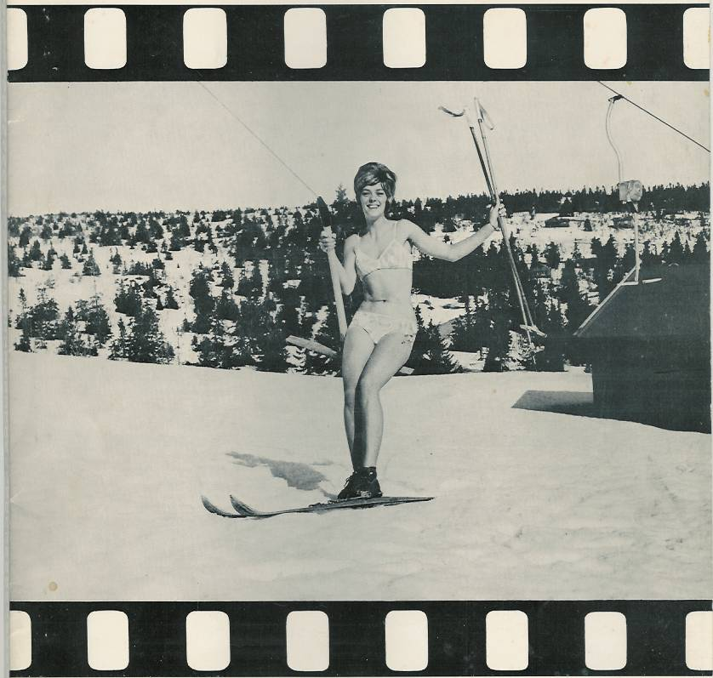
The engine T-bar lift Müller 1966

Slide 21
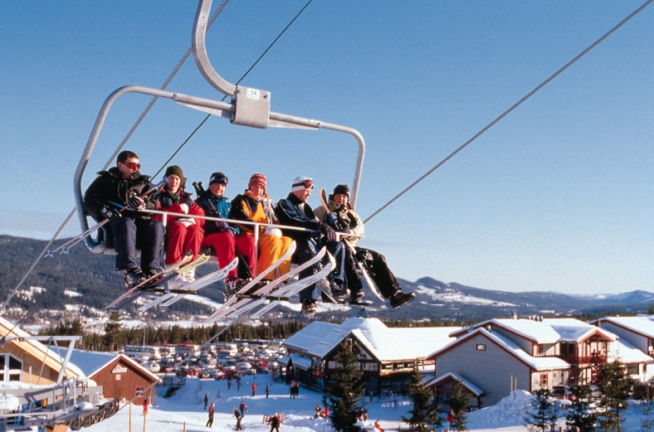
Six seater 1995

Slide 22
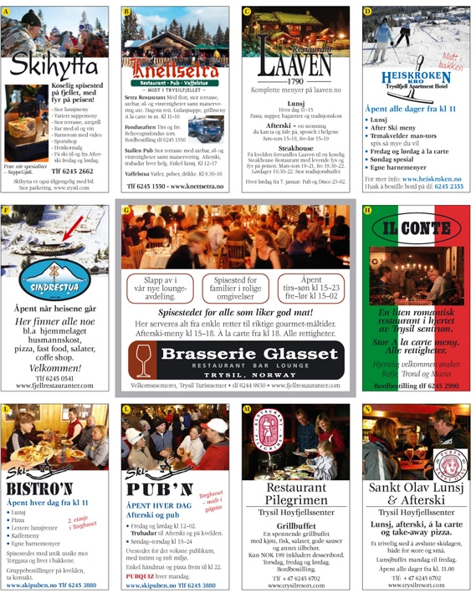
The restaurant guide

Slide 26
Inhabitants Trysil kommune: 6.700 total Trysil village: 2.400

Slide 27
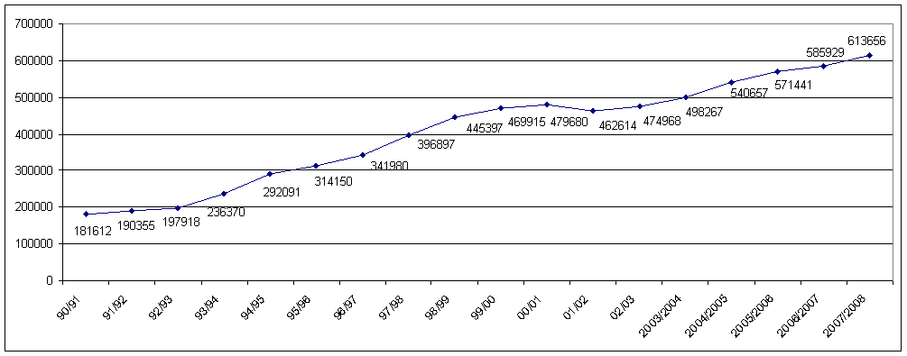
Winter guest nights

Slide 28
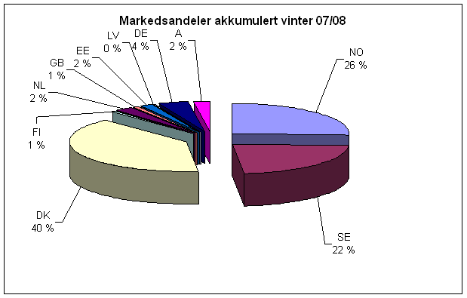
Nationalities

Slide 29
The engine and main travel reason to Trysil

Slide 30
Figures:
1400 persons works in the tourism industry directly or in-directly.
That´s close to 50% of the working population.
750 mill. NOK (94 mill. EUROS) is tourist consumption on accommodation, restaurants, groceries, transportation and acitivities.

